Slide 1
Unit 9
10.0 Building Better Forms
- Validation
(Text Book Chapter 9)

Slide 2
10.0 Building Better Forms - Validation
10.0 Understanding Validation
10.1 Common User Mistakes
Common knowledge as developers is that the users, when using any
application will make mistakes when entering data. What’s particularly
daunting is the range of possible mistakes that users can make. Here are
some common examples:
Users might ignore an important field and leave it blank.
Users might try to type a short string of nonsense to circumvent a required field check, thereby creating endless headaches on your end. For example, you might get stuck with an invalid e-mail address that causes problems for your automatic e-mailing program.
Users might make an honest mistake, such as entering a typing error, entering a nonnumeric character in a number field, or submitting the wrong type of information. They might even enter several pieces of information that are individually correct but when taken together are inconsistent (for example, entering a MasterCard number after choosing Visa as the payment type).
Malicious users might try to exploit a weakness in your code by entering carefully structured wrong values. For example, they might attempt to cause a specific error that will reveal sensitive information. A more dramatic example of this technique is the SQL injection attack, where user-supplied values change the operation of a dynamically constructed database command. (Of course, validation is no defense for poor coding. In a later chapter you’ll learn how to use parameterized commands, which avoid the danger of SQL injection attacks altogether.) A web application is particularly susceptible to these problems, because it relies on basic HTMLinput controls that don’t have all the features of their Windows counterparts.
2
Prepared By Kumar Peeris Web Application Development CSCI/CINF 4320

Slide 3
10.0 Building Better Forms - Validation
A web application is particularly susceptible to these problems, because it
relies on basic HTML input controls that don't have all the features of their
Windows counterparts. For example, a common technique in a Windows
application is to handle the KeyPress event of a text box, check to see
whether the current character is valid, and prevent it from appearing if it
isn't. This technique makes it easy to create a text box that accepts only
numeric input.
In web applications, however, you don't have that sort of fine-grained
control. To handle a KeyPress event, the page would have to be posted back
to the server every time the user types a letter, which would slow down the
application hopelessly. Instead, you need to perform all your validation at
once when a page (which may contain multiple input controls) is submitted.
You then need to create the appropriate user interface to report the
mistakes. Some websites report only the first incorrect field, while others
use a table, list, or window to describe them all. By the time you've
perfected your validation strategy, you'll have spent a considerable amount
of effort writing tedious code.
ASP.NET aims to save you this trouble and provide you with a reusable
framework of validation controls that manages validation details by
checking fields and reporting on errors automatically. These controls can
even use client-side JavaScript to provide a more dynamic and responsive
interface while still providing ordinary validation for older browsers (often
referred to as down-level browsers).
3
Prepared By Kumar Peeris Web Application Development CSCI/CINF 4320

Slide 4
10.0 Building Better Forms - Validation
10.1.1 The Validation Controls
ASP.NET provides five validation controls, which are described in Table 10-1.
Four are targeted at specific types of validation, while the fifth allows you to
apply custom validation routines. You'll also see a ValidationSummary
control in the Toolbox, which gives you another option for showing a list of
Validation error messages in one place. You'll learn about the
ValidationSummary later in this chapter (see the "Other Display Options“
section).
Table Validator Controls
Control Class | Description
RequiredFieldValidator | Validation succeeds as long as the input control doesn't contain an empty string.
RangeValidator | Validation succeeds if the input control contains a value within a specific numeric, alphabetic, or date range.
CompareValidator | Validation succeeds if the input control contains a value that matches the value in another input control, or a fixed value that you specify.
RegularExpressionValidator | Validation succeeds if the value in an input control matches a specified regular expression.
CustomValidator | Validation is performed by a user-defined function.
Figure 10.1-1 – Type of Validation Controls
The above validation controls are found in the System.Web.UI.WebControls
namespace and inherit from the BaseValidator. Each validation control can
be bound to a single input control. In addition, you can apply more than one
validation control to the same input control to provide multiple types of
validation. If you use the RangeValidator, CompareValidator, or
RegularExpressionValidator, validation will automatically succeed if the
input control is empty, because there is no value to validate. If this isn't the
behavior you want, you should also add a RequiredFieldValidator and link it
to the same input control. This ensures that two types of validation will be
performed, effectively restricting blank values.
4
Prepared By Kumar Peeris Web Application Development CSCI/CINF 4320

Slide 5
10.0 Building Better Forms - Validation
10.1.2 Server Side Validation
You can use the validation controls to verify a page automatically when the
user submits it or manually in your code. The first approach is the most
common.
When using automatic validation, the user receives a normal page and
begins to fill in the input controls. When finished, the user clicks a button to
submit the page. Every button has a CausesValidation property, which can
be set to true or false. What happens when the user clicks the button
depends on the value of the CausesValidation property. If CausesValidation
is false, ASP.NET will ignore the validation controls, the page will be posted
back, and your event-handling code will run normally.
If CausesValidation is true (the default), ASP.NET will automatically validate
the page when the user clicks the button. It does this by performing the
validation for each control on the page. If any control fails to validate,
ASP.NET will return the page with some error information, depending on
your settings. Your click event-handling code may or may not be executed
-meaning you'll have to specifically check in the event handler whether the
page is valid.
Based on this description, you'll realize that validation happens automatically
when certain buttons are clicked. It doesn't happen when the page is posted
back because of a change event (such as choosing a new value in an
AutoPostBack list) or if the user clicks a button that has CausesValidation set
to false. However, you can still validate one or more controls manually and
then make a decision in your code based on the results. You'll learn about
this process in more detail a little later (see the "Manual Validation" section).
NOTE: Many other button-like controls that can be used to submit the page
also provide the CausesValidation property. Examples include the
LinkButton, ImageButton, and BulletedList.
In most modern browsers (including Internet Explorer 5 or later and any
version of Firefox), ASP.NET automatically adds JavaScript code for client-
side validation. In this case, when the user clicks a CausesValidation button
5
Prepared By Kumar Peeris Web Application Development CSCI/CINF 4320

Slide 6
10.0 Building Better Forms - Validation
the same error messages will appear without the page needing to be
submitted and returned from the server. This increases the responsiveness
of your web page.
However, even if the page validates successfully on the client side, ASP.NET
still revalidates it when it's received at the server. This is because it's easy for
an experienced user to circumvent client-side validation. For example, a
malicious user might delete the block of JavaScript validation code and
continue working with the page. By performing the validation at both ends,
ASP.NET makes sure your application can be as responsive as possible while
also remaining secure.
10.1.3 Validation Control Properties
As said, all Validation controls inherit from the BaseValidator class which
defines the basic functionality for a validation control. The table 10.1-2
describes key properties BaseValidator class has. Therefore these properties
are inherited to other validation controls.
Table Properties of the BaseValidator Class
Property | Description
ControlToValidate | Identifies the control that this validator will check. Each validator can verify the value in one input control. However, it's perfectly reasonable to "stack" validators—in other words, attach several validators to one input control to perform more than one type of error checking.
ErrorMessage and ForeColor | If validation fails, the validator control can display a text message (set by the ErrorMessage property). By changing the ForeColor, you can make this message stand out in angry red lettering.
Display | Allows you to conFigure whether this error message will be inserted into the page dynamically when it's needed (Dynamic) or whether an appropriate space will be reserved for the message (Static). Dynamic is useful when you're placing several validators next to each other. That way, the space will expand to fit the currently active error indicators, and you won't be left with any unseemly whitespace. Static is useful when the validator is in a table and you don't want the width of the cell to collapse when no message is displayed Finally, you can also choose None to hide the error message altogether.
IsValid | After validation is performed, this returns true or false depending on whether it succeeded or failed. Generally, you'll check the state of the entire page by looking at its IsValid property instead to find out if all the validation controls succeeded.
Enabled | When set to false, automatic validation will not be performed for this control when the page is submitted.
EnableClientScript | If set to true, ASP.NET will add JavaScript and DHTML code to allow client-side validation on browsers that support it.
Figure 10.1-2 – BaseValidator class Properties
6
Prepared By Kumar Peeris Web Application Development CSCI/CINF 4320

Slide 7
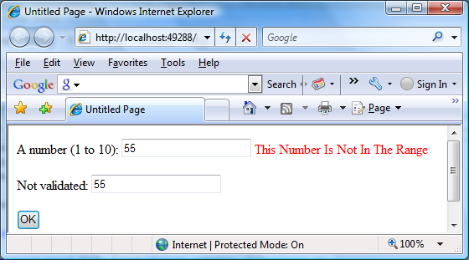
10.0 Building Better Forms - Validation
When using a validation control, the only properties you need to implement
are ControlToValidate and ErrorMessage. In addition, you may need to
implement the properties that are used for your specific validator.
Table 10.1-3 outlines these properties.
Table Validator-Specific Properties
Validator Control | Added Members
RequiredFieldValidator | None required
RangeValidator | MaximumValue, MinimumValue, Type
CompareValidator | ControlToCompare, Operator, Type, ValueToCompare
RegularExpressionValidator | ValidationExpression
CustomValidator | ClientValidationFunction, ValidateEmptyText, ServerValidate event
Figure 10.1-3 – BaseValidator’s Implementable Properties
RangeValidator Example:
A Simple Validation Example To understand how validation works, you can
create a simple web page. This test uses a single Button web control, two
TextBox controls, and a RangeValidator control that validates the first text
box. If validation fails, the RangeValidator control displays an error message,
so you should place this control immediately next to the TextBox it's
validating. The second text box does not use any validation. The figure 10.1-4
shows the appearance of the page after a failed validation attempt.
Figure 10.1-4 – Validation Example
7
Prepared By Kumar Peeris Web Application Development CSCI/CINF 4320

Slide 8
10.0 Building Better Forms - Validation
In addition, place a Label control at the bottom of the form. This label will
report when the page has been posted back and the event-handling code
has executed. Disable its EnableViewState property to ensure that it will be
cleared every time the page is posted back.
The markup for this page defines a RangeValidator control, sets the error
message, identifies the control that will be validated, and requires an integer
from 1 to 10. These properties are set in the .aspx file, but they could also be
configured in the event handler for the Page.Load event. The Button
automatically has its CauseValidation property set to true, because this is
the default.
Here is the code that responds to the button click:
If you're testing this web page in a modern browser, you'll notice an
interesting trick. When you first open the page, the error message is hidden.
But if you type an invalid number (remember, validation will succeed for an
empty value) and press the Tab key to move to the second text box, an error
message will appear automatically next to the offending control. This is
because ASP.NET adds a special JavaScript function that detects when the
focus changes.
A number (1 to 10):
<asp:TextBox id="txtValidated" runat="server" />
<asp:RangeValidator id="RangeValidator" runat="server"
ErrorMessage="This Number Is Not In The Range“ ControlToValidate="txtValidated"
MaximumValue="10" MinimumValue="1“ Type="Integer" />
<br /><br />
Not validated:
<asp:TextBox id="txtNotValidated" runat="server" /><br /><br />
<asp:Button id="cmdOK" runat="server" Text="OK" OnClick="cmdOK_Click" />
<br /><br />
<asp:Label id="lblMessage" runat="server"
EnableViewState="False" />
Example 10.1-1a – Using a RangeValidator
protected void cmdOK_Click(Object sender, EventArgs e)
{
lblMessage.Text = "cmdOK_Click event handler executed.";
}
Example 10.1-1b – Code Behind
8
Prepared By Kumar Peeris Web Application Development CSCI/CINF 4320

Slide 9
10.0 Building Better Forms - Validation
The actual implementation of this JavaScript code is somewhat complicated,
but ASP.NET handles all the details for you automatically. As a result, if you
try to click the OK button with an invalid value in txtValidated, your actions
will be Ignored and the page won't be posted back.
Not all browsers will support client-side validation. To see what will happen
on a down-level browser, set the RangeValidator.EnableClientScript
property to false, and rerun the page. Now error messages won't appear
dynamically as you change focus. However, when you click the OK button,
the page will be returned from the server with the appropriate error
message displayed next to the invalid control.
The potential problem in this scenario is that the click event-handling code
will still execute, even though the page is invalid. To correct this problem and
ensure that your page behaves the same on modern and older browsers,
you must specifically abort the event code if validation hasn't been
performed successfully.
The code (next slide) solves the current problem, but it isn't much help if the
page contains multiple validation controls. Fortunately, every web form
provides its own IsValid property. This property will be false if any validation
control has failed. It will be true if all the validation controls completed
successfully. If validation was not performed (for example, if the Validation
controls are disabled or if the button has CausesValidation set to false),
you'll get an HttpException when you attempt to read the IsValid property.
protected void cmdOK_Click(Object sender, EventArgs e)
{
// Abort the event if the control isn't valid.
if (!RangeValidator.IsValid) return;
lblMessage.Text = "cmdOK_Click event handler executed.";
}
Example 10.1-1c – Modified Code Behind
9
Prepared By Kumar Peeris Web Application Development CSCI/CINF 4320

Slide 10
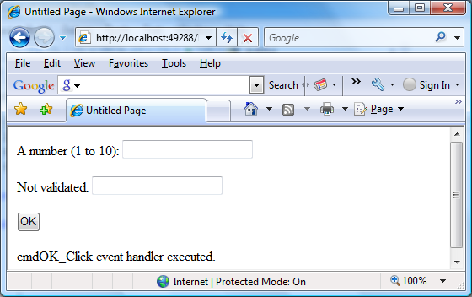
10.0 Building Better Forms - Validation
protected void cmdOK_Click(Object sender, EventArgs e)
{
// Abort the event if any control on the page is invalid.
if (!Page.IsValid) return;
lblMessage.Text = "cmdOK_Click event handler executed.";
}
Example 10.1-1d – Code Behind with IsValid property check
Figure 10.1-5 – Page is invalid
10
Prepared By Kumar Peeris Web Application Development CSCI/CINF 4320

Slide 11
10.0 Building Better Forms - Validation
10.1.3 Other Display Options – ValidationSummary
In some cases, you might have already created a carefully designed form
that combines multiple input fields. Perhaps you want to add validation to
this page, but you can't reformat the layout to accommodate all the error
messages for all the validation controls. In this case, you can save some work
by using the ValidationSummary control. To try this, set the Display property
of the RangeValidator control to None. This ensures the error message will
never be displayed. However, validation will still be performed and the user
will still be prevented from successfully clicking the OK button if some invalid
information exists on the page. Next, add the ValidationSummary in a
suitable location (such as the bottom of the page). A standard Validation
Summary control will look like this:
<asp:ValidationSummary id="Errors" runat="server" />
<body>
<form id="form1" runat="server">
<div>
A number (1 to 10):
<asp:TextBox id="txtValidated" runat="server" />
<asp:RangeValidator id="RangeValidator" runat="server"
ErrorMessage="This Number Is Not In The Range"
ControlToValidate="txtValidated"
MaximumValue="10" MinimumValue="1"
Type="Integer" />
<br /><br />
Not validated:
<asp:TextBox id="txtNotValidated" runat="server" /><br /><br />
<asp:Button id="cmdOK" runat="server" Text="OK" OnClick="cmdOK_Click" />
<br /><br />
<asp:ValidationSummary id="Errors" runat="server" />
</div>
</form>
</body>
Example 10.1-2a – Adding a ValidationSummary
11
Prepared By Kumar Peeris Web Application Development CSCI/CINF 4320

Slide 12
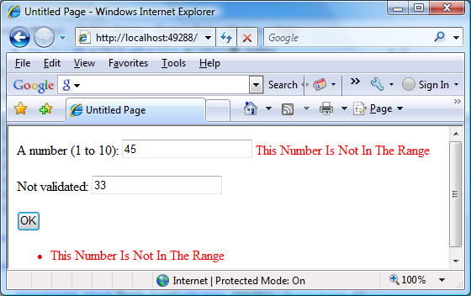
10.0 Building Better Forms - Validation
Code behind is not virtually blank.
protected void cmdOK_Click(Object sender, EventArgs e)
{
// Abort the event if any control on the page is invalid.
//if (!Page.IsValid) return;
//lblMessage.Text = "cmdOK_Click event handler executed.";
}
Example 10.1-2b – Adding a ValidationSummary
But still you see a ValidationSummary
Figure 10.1-6 – Page with a ValidationSummary
10.1.3.1 Validation Summary with Error Indicator
When the ValidationSummary displays the list of errors, it automatically
retrieves the value of the ErrorMessage property from each validator. In
some cases, you'll want to display a full message in the summary and some
sort of visual indicator next to the offending control. For example, many
websites use an error icon or an asterisk to highlight text boxes with invalid
input. You can use this technique with the help of the Text property of the
validators. Ordinarily, Text is left empty. However, if you set both Text and
ErrorMessage, the ErrorMessage value will be used for the summary while
the Text value is displayed in the validator. (Of course, you'll need to make
sure you aren't also setting the Display property of your validator to None,
which hides it completely.)
12
Prepared By Kumar Peeris Web Application Development CSCI/CINF 4320

Slide 13
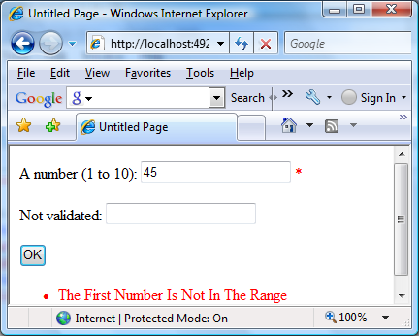
10.0 Building Better Forms - Validation
Here's an example of a validator that includes a detailed error message
(which will appear in the ValidationSummary) and an asterisk indicator
(which will appear in the validator, next to the control that has the problem):
<asp:RangeValidator id="RangeValidator" runat="server"
Text="*" ErrorMessage="The First Number Is Not In The Range"
ControlToValidate="txtValidated"
MaximumValue="10" MinimumValue="1" Type="Integer" />
You can even get a bit fancier by replacing the plain asterisk with a snippet
of more interesting HTML. Here's an example that uses the <img> tag to add
a small error icon image when validation fails:
<asp:RangeValidator id="RangeValidator" runat="server"
Text="<img src='ErrorIcon.gif' />" alt='Error' ... />
<asp:ValidationSummary id="Errors" runat="server" />
Figure 10.1-7 – A ValidationSummary with Error Indicator
13
Prepared By Kumar Peeris Web Application Development CSCI/CINF 4320

Slide 14

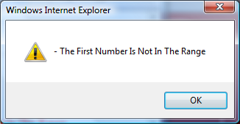
10.0 Building Better Forms - Validation
10.1.3.2 Validation Summary with MessageBox
The ValidationSummary control provides some useful properties you can
use to fine-tune the error display. You can set the HeaderText property to
display a special title at the top of the list (such as Your page contains the
following errors: ). You can also change the ForeColor and choose a
DisplayMode. The possible modes are BulletList (the default), List, and
SingleParagraph.
Finally, you can choose to have the validation summary displayed in a pop-up
dialog box instead of on the page (see Figure 10.1-8). This approach has the
advantage of leaving the user interface of the page untouched, but it also
forces the user to dismiss the error messages by closing the window before
being able to modify the input controls. If users will need to refer to these
messages while they fix the page, the inline display is better.
To show the summary in a dialog box, set the ShowMessageBox property of
the ValidationSummary to true. Keep in mind that unless you set the
ShowSummary property to false, you'll see both the message box and the
In-page summary (as in Figure 10.1-8).
<asp:ValidationSummary id="Errors" runat="server"
ShowMessageBox="true" />
Figure 10.1-8 – A ValidationSummary with MessageBox
14
Prepared By Kumar Peeris Web Application Development CSCI/CINF 4320

Slide 15
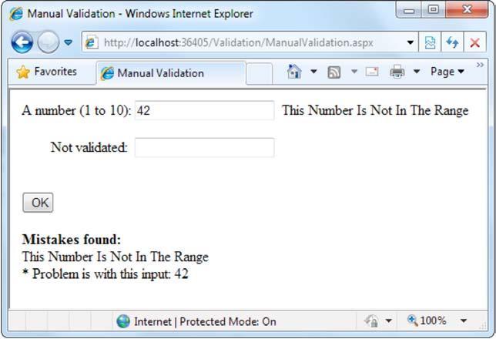
10.0 Building Better Forms - Validation
10.1.3.3 Manual Validation
Your final option is to disable validation and perform the work on your own,
with the help of the validation controls. This allows you to take other
information into consideration or create a specialized error message that
involves other controls (such as images or buttons).
You can create manual validation in one of three ways:
• Use your own code to verify values. In this case, you won't use any of the
ASP.NET validation controls.
• Disable the EnableClientScript property for each validation control. This
allows an invalid page to be submitted, after which you can decide what
to do with it depending on the problems that may exist.
• Add a button with CausesValidation set to false. When this button is
clicked, manually validate the page by calling the Page.Validate() method.
Then examine the IsValid property, and decide what to do.
The next example uses the second approach. Once the page is submitted, it
examines all the validation controls on the page by looping through the
Page.Validators collection. Every time it finds a control that hasn't validated
successfully, it retrieves the invalid value from the input control and adds it
to a string. At the end of this routine, it displays a message that describes
which values were incorrect, as shown in Figure 10.19.
Figure 10.1-9 – A Manual Validation
15
Prepared By Kumar Peeris Web Application Development CSCI/CINF 4320

Slide 16
10.0 Building Better Forms - Validation
This technique adds a feature that wouldn't be available with automatic
validation, which uses the ErrorMessage property. In that case, it isn't
possible to include the actual incorrect values in the message.
Here's the event handler that checks for invalid values:
This example uses an advanced technique: the Page.FindControl() method.
It's required because the ControlToValidate property of each validator simply
provides a string with the name of a control, not a reference to the actual
control object. To find the control that matches this name (and retrieve its
Text property), you need to use the FindControl() method. Once the code
has retrieved the matching text box, it can perform other tasks such as
clearing the current value, tweaking a property, or even changing the text
box color. Note that the FindControl() method returns a generic Control
reference, because you might search any type of control. To access all the
properties of your control, you need to cast it to the appropriate type (such
as TextBox in this example).
protected void cmdOK_Click(Object sender, EventArgs e)
{
string errorMessage = "<b>Mistakes found:</b><br />";
// Search through the validation controls.
foreach (BaseValidator ctrl in this.Validators)
{
if (!ctrl.IsValid)
{
errorMessage += ctrl.ErrorMessage + "<br />";
// Find the corresponding input control, and change the
// generic Control variable into a TextBox variable.
// This allows access to the Text property.
TextBox ctrlInput =
(TextBox)this.FindControl(ctrl.ControlToValidate);
errorMessage += " * Problem is with this input: ";
errorMessage += ctrlInput.Text + "<br />";
}
}
lblMessage.Text = errorMessage;
}
Example 10.1-3 – Manual Validation Code Behind
16
Prepared By Kumar Peeris Web Application Development CSCI/CINF 4320

Slide 17
10.0 Building Better Forms - Validation
10.2 Validation with Regular Expressions
One of ASP.NET's most powerful validation controls is the
RegularExpressionValidator, which validates text by determining whether
or not it matches a specific pattern. For example, e-mail addresses, phone
numbers, and file names are all examples of text that has specific
constraints. A phone number must be a set number of digits, an e-mail
address must include exactly one @ character (with text on either side),
and a file name can't include certain special characters like \ and ?. One way
to define patterns like these is with regular expressions.
Regular expressions have appeared in countless other languages and
gained popularity as an extremely powerful way to work with strings. In
fact, Visual Studio even allows programmers to perform a search-and-
replace operation in their code using a regular expression . Regular
expressions can almost be considered an entire language of their own. How
to master all the ways you can use regular expressions-including pattern
matching, back references, and named groups—could occupy an entire
book (and several books are dedicated to just that subject). Fortunately,
you can understand the basics of regular expressions without nearly that
much work.
10.2.1Literals and Metacharacters
All regular expressions consist of two kinds of characters: literals and
metacharacters. Literals are not unlike the string literals you type in code.
They represent a specific defined character. For example, if you search for
the string literal "l", you'll find the character l and nothing else.
Metacharacters provide the true secret to unlocking the full power of
regular expressions. You're probably already familiar with two
metacharacters from the DOS world (? and *). Consider the command-line
expression shown here:
Del *.*
17
Prepared By Kumar Peeris Web Application Development CSCI/CINF 4320

Slide 18
10.0 Building Better Forms - Validation
The expression *.* contains one literal (the period) and two metacharacters
(the asterisks). This translates as "delete every file that starts with any
number of characters and ends with an extension of any number of
characters (or has no extension at all)." Because all files in DOS implicitly
have extensions, this has the well-documented effect of “deleting
Everything” in the current directory.
Another DOS metacharacter is the question mark, which means "any single
character." For example, the following statement deletes any file named
hello that has an extension of exactly one character.
Del hello.?
The regular expression language provides many flexible metacharacters –
far more than the DOS command line. For example, \s represents any
whitespace character (such as a space or tab). \d represents any digit. Thus,
the following expression would match any string that started with the
numbers 333, followed by a single whitespace character and any three
numbers. Valid matches would include 333 333 and 333 945 but not 334 333
or 3334 945.
333\s\d\d\d
One aspect that can make regular expressions less readable is that they use
special metacharacters that are more than one character long. In the
previous example, \s represents a single character, as does \d, even though
they both occupy two characters in the expression.
You can use the plus (+) sign to represent a repeated character. For example,
5+7 means "one or more occurrences of the character 5, followed by a
single 7." The number 57 would match, as would 555557. You can also use
parentheses to group a subexpression. For example, (52)+7 would match
any string that started with a sequence of 52. Matches would include 527,
52527, 5252527, and so on.
18
Prepared By Kumar Peeris Web Application Development CSCI/CINF 4320

Slide 19
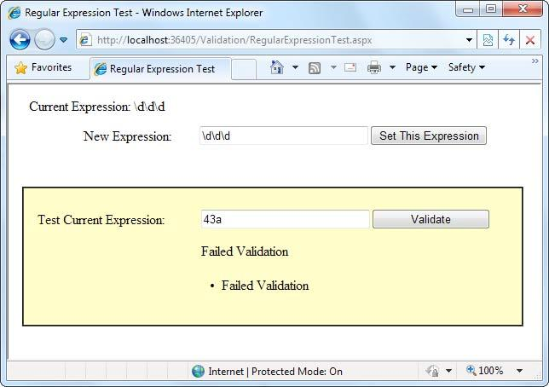
10.0 Building Better Forms - Validation
You can also delimit a range of characters using square brackets. [a-f] would
match any single character from a to f (lowercase only). The following
expression would match any word that starts with a letter from a to f ,
contains one or more "word" characters (letters), and ends withing—
possible matches. (Examples acting and developing etc.)
[a-f]\w+ing
The following is a more useful regular expression that can match any e-mail
address by verifying that it contains the @ symbol. The dot is a
metacharacter used to indicate any character except newline. However,
some invalid e-mail addresses would still be allowed, including those that
contain spaces and those that don't include a dot (.). You'll see a better
example a little later in the customer form example.
.+@.+
10.2.2 Finding a Regular Expression
Clearly, picking the perfect regular expression may require some testing. In
fact, numerous reference materials (on the Internet and in paper form)
include useful regular expressions for validating common values such as
postal codes. To experiment, you can use the simple RegularExpressionTest
page included with the online samples, which is shown in Figure 10.2-1. It
allows you to set a regular expression that will be used to validate a control.
Then you can type in some sample values and see whether the regular
expression validation succeeds or fails.
Figure 10.2-1 – A Regular Expression Test
19
Prepared By Kumar Peeris Web Application Development CSCI/CINF 4320

Slide 20
10.0 Building Better Forms - Validation
The code is quite simple. The Set This Expression button assigns a new
regular expression to the RegularExpressionValidator control (using
whatever text you have typed). The Validate button simply triggers a
postback, which causes ASP.NET to perform validation automatically. If an
error message appears, validation has failed. Otherwise, it's successful.
public partial class RegularExpressionTest : System.Web.UI.Page
{
protected void cmdSetExpression_Click(Object sender, EventArgs e) {
TestValidator.ValidationExpression = txtExpression.Text;
lblExpression.Text = "Current Expression: ";
lblExpression.Text += txtExpression.Text;
}
}
Example 10.2-1 – Regular Expression Test Code Behind
10.2.3 Regular Expression Building Blocks
Table 11-4 shows some of the fundamental regular expression building blocks. If you need to match a literal character with the same name as a special character, you generally precede it with a \ character. For example, \*hello\* matches *hello* in a string, because the special asterisk (*) character is preceded by a slash (\).
Table Regular Expression Characters
Character | Description
* | Zero or more occurrences of the previous character or subexpression. For example, 7*8 matches 7778 or just 8.
+ | One or more occurrences of the previous character or subexpression. For example, 7+8 matches 7778 but not 8.
( ) | Groups a subexpression that will be treated as a single element. For example, (78)+ matches 78 and 787878.
{m,n} | The previous character (or subexpression) can occur from m to n times. For example, A{1,3} matches A, AA, or AAA.
| | Either of two matches. For example, 8|6 matches 8 or 6.
[ ] | Matches one character in a range of valid characters. For example, [A-C] matches A, B, or C.
[^ ] | Matches a character that isn't in the given range. For example, [^A-B] matches any character except A and B.
. | Any character except newline. For example, .here matches where and there.
\s | Any whitespace character (such as a tab or space).
\S | Any nonwhitespace character.
\d | Any digit character.
\D | Any character that isn't a digit.
\w | Any "word" character (letter, number, or underscore).
\W | Any character that isn't a "word" character (letter, number, or underscore).
Figure 10.2-2 – Regular Expression Characters
20
Prepared By Kumar Peeris Web Application Development CSCI/CINF 4320

Slide 21
10.0 Building Better Forms - Validation
10.2.4 Common Regular Expressions
Table in figure 10.2-3 shows a few common (and useful) regular expressions.
Table Commonly Used Regular Expressions
Content | Regular Expression | Description
E-mail address | \S+@\S+\.\S+ | Check for an at (@) sign and dot (.) and allow nonwhitespace characters only.
Password | \w+ | Any sequence of one or more word characters (letter, space, or underscore).
Specific-length password | \w{4,10} | A password that must be at least four characters long but no longer than ten characters.
Advanced password | [a-zA-Z]\w{3,9} | As with the specific-length password, this regular expression will allow four to ten total characters. The twist is that the first character must fall in the range of a-z or A-Z (that is to say. it must start with a nonaccented ordinary letter).
Another advanced password | [a-zA-Z]\w[]\d+\w[] | This password starts with a letter character, followed by zero or more word characters, one or more digits, and then zero or more word characters. In short, it forces a password to contain one or more numbers somewhere inside it. You could use a similar pattern to require two numbers or any other special character.
Limited-length field | \S{4,10} | Like the password example, this allows four to ten characters, but it allows special characters (asterisks, ampersands, and so on).
U.S. Social Security number | \d{3}-\d{2}-\d{4} | A sequence of three, two, then four digits, with each group separated by a dash. You could use a similar pattern when requiring a phone number.
Figure 10.2-3 – Common Regular Expressions
You have many different ways to validate e-mail addresses with regular expressions of varying complexity. See http://www.4guysfromrolla.com/webtech/validateemail.shtml for a discussion of the subject and numerous examples.
Some logic is much more difficult to model in a regular expression. An example is the Luhn algorithm, which verifies credit card numbers by first doubling every second digit, then adding these doubled digits together, and finally dividing the sum by ten. The number is valid (although not necessarily connected to a real account) if there is no remainder after dividing the sum. To use the Luhn algorithm, you need a CustomValidator control that runs this logic on the supplied value. (You can find a detailed description of the Luhn algorithm at http://en.wikipedia.org/wiki/Luhn_formula.)
21
Prepared By Kumar Peeris Web Application Development CSCI/CINF 4320

Slide 22

10.0 Building Better Forms - Validation
10.2.5 Using Regular Expressions in ASP.NET form.
Regular expressions can be added to most of the ASP components by using
a RegularExpressionValidator. Following example shows how a regular expression can be added to a web control by using a RegularExpressionValidator. In the example below, the text field concerned should accept only 1-40 alpha characters.
<%@ language="C#" %>
<form id="form1" runat="server">
<asp:TextBox ID="txtName" runat="server"/>
<asp:Button ID="btnSubmit" runat="server" Text="Submit" />
<asp:RegularExpressionValidator ID="regexpName" runat="server"
ErrorMessage=“Allowed only 1-40 alpha characters!"
ControlToValidate="txtName"
ValidationExpression="^[a-zA-Z'.\s]{1,40}$" />
</form>
Example 10.2-2 – Regular Expression usage
The regular expression used in the preceding code example constrains an input name field to alphabetic characters (lowercase and uppercase), space characters, the single quotation mark (or apostrophe) for names such as O'Dell, and the period or dot character. In addition, the field length is constrained to 40 characters.
Using ^ and $
Enclosing the expression in the caret (^) and dollar sign ($)markers ensures that the expression consists of the desired content and nothing else. A ^ matches the position at the beginning of the input string and a $ matches the position at the end of the input string. If you omit these markers, an attacker could affix malicious input to the beginning or end of valid content and bypass your filter.
Figure 10.2-4– Regular Expressions in Action
22
Prepared By Kumar Peeris Web Application Development CSCI/CINF 4320

Slide 23
10.0 Building Better Forms - Validation
10.2.6 Using Regex Class
If you are not using server controls (which means you cannot use the validation controls) or if you need to validate input from sources other than form fields, such as query string parameters or cookies, or even web controls that you want to check on server side, you can use the Regex class within the System.Text.RegularExpressions namespace.
Using the Regex class:
Add a using statement to reference the System.Text.RegularExpressions namespace. Call the IsMatch method of the Regex class, as shown in the following example.
and on code behind, you validate it like this…
<form id="form1" runat="server">
<div>
<asp:TextBox ID="txtName" runat="server"/>
<asp:Button ID="btnSubmit" runat="server" Text="Submit"
OnClick="CheckValidity"/>
</div>
</form>
Example 10.2-3a – Using Regex class, front end
protected void CheckValidity(object sender, EventArgs e)
{
if (!Regex.IsMatch(txtName.Text, @"^[a-zA-Z'.]{1,40}$"))
{
Response.Write("Expression Does not match");
}
}
Example 10.2-3b – Using Regex class, code behind
23
Prepared By Kumar Peeris Web Application Development CSCI/CINF 4320

Slide 24
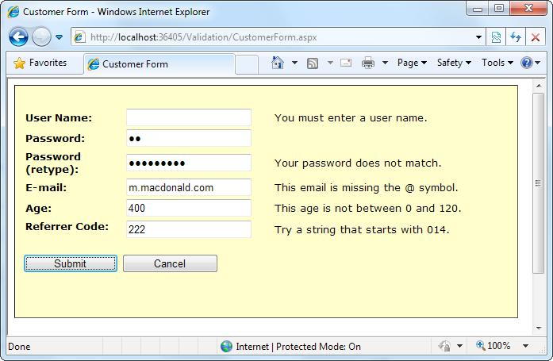
10.0 Building Better Forms - Validation
A Validated Customer Form:
To bring together these various topics, you'll now see a full-fledged web
form that combines a variety of pieces of information that might be needed
to add a user record (for example, an e-commerce site shopper or a content
site subscriber). Figure 10.2-5 shows this form.
Several types of validation are taking place on the customer form:
• Three RequiredFieldValidator controls make sure the user enters a user
name, a password, and a password confirmation.
• A CompareValidator ensures that the two versions of the masked
password match.
• A RegularExpressionValidator checks that the e-mail address contains an
at (@) symbol.
• A RangeValidator ensures the age is a number from 0 to 120.
• A CustomValidator performs a special validation on the server of a
"referrer code." This code verifies that the first three characters make up
a number that is divisible by 7.
ID=“txtUserName”
ID=“txtPassword”
ID=“txtRetype”
ID=“txtEmail”
ID=“txtAge”
ID=“txtCode”
ID=“cmdCancel”
ID=“cmdSubmit”
Figure 10.2-5– A form with different Regular Expressions
24
Prepared By Kumar Peeris Web Application Development CSCI/CINF 4320

Slide 25
10.0 Building Better Forms - Validation
The implementation of these Validation Controls are shown below.
<asp:RequiredFieldValidator id="vldUserName" runat="server"
ErrorMessage="You must enter a user name."
ControlToValidate="txtUserName" />
<asp:RequiredFieldValidator id="vldPassword" runat="server"
ErrorMessage="You must enter a password."
ControlToValidate="txtPassword" />
<asp:CompareValidator id="vldRetype" runat="server"
ErrorMessage="Your password does not match."
ControlToCompare="txtPassword" ControlToValidate="txtRetype”/>
<asp:RequiredFieldValidator id="vldRetypeRequired"
runat="server“ ErrorMessage="You must confirm your password."
ControlToValidate="txtRetype" />
<asp:RegularExpressionValidator id="vldEmail" runat="server"
ErrorMessage="This email is missing the @ symbol."
ValidationExpression=".+@.+" ControlToValidate="txtEmail" />
<asp:RangeValidator id="vldAge" runat="server"
ErrorMessage="This age is not between 0 and 120."
Type="Integer“ MinimumValue="0" MaximumValue="120"
ControlToValidate="txtAge" />
<asp:CustomValidator id="vldCode" runat="server"
ErrorMessage="Try a string that starts with 014."
ValidateEmptyText="False”
OnServerValidate="vldCode_ServerValidate"
ControlToValidate="txtCode" />
The form provides two validation buttons—one that requires validation and one that allows the user to cancel the task gracefully:
<asp:Button id="cmdSubmit" runat="server"
OnClick="cmdSubmit_Click" Text="Submit"></asp:Button>
<asp:Button id="cmdCancel" runat="server"
CausesValidation="False" OnClick="cmdCancel_Click”
Text="Cancel"> </asp:Button>
25
Prepared By Kumar Peeris Web Application Development CSCI/CINF 4320

Slide 26
10.0 Building Better Forms - Validation
The buttons “Submit” and “Cancel” both handles events in the code
behind. Here are the two event handlers.
protected void cmdSubmit_Click(Object sender, EventArgs e)
{
if (Page.IsValid) {
lblMessage.Text = "This is a valid form.";
}
}
protected void cmdCancel_Click(Object sender, EventArgs e)
{
lblMessage.Text = "No attempt was made to validate this form.";
}
Example 10.2-4 – Event Handlers for Submit and Cancel buttons
The only form-level code that is required for validation is the custom validation code. The validation takes place in the event handler for the CustomValidator.ServerValidate event. This method receives the value it needs to validate (e.Value) and sets the result of the validation to true or false (e.IsValid).
protected void vldCode_ServerValidate(Object source, ServerValidateEventArgs e)
{
try {
// Check whether the first three digits are divisible by seven.
int val = Int32.Parse(e.Value.Substring(0, 3));
if (val % 7 == 0) { e.IsValid = true; }
else { e.IsValid = false; }
}
catch (Exception exp) {
// An error occurred in the conversion. The value is not valid.
e.IsValid = false;
}
}
Example 10.2-5 – ServerValidate event handler
26
Prepared By Kumar Peeris Web Application Development CSCI/CINF 4320

Slide 27
10.0 Building Better Forms - Validation
This example also introduces one new detail: error handling. This error-
handling code ensures that potential problems are caught and dealt with
appropriately. Without error handling, your code may fail, leaving the user
with nothing more than a cryptic error page. The reason this example
requires error-handling code is because it performs two steps that aren't
guaranteed to succeed. First, the Int32.Parse() method attempts to convert
the data in the text box to an integer.
An error will occur during this step if the information in the text box is
nonnumeric (for example, if the user entered the characters 4G). Similarly,
the String.Substring() method, which extracts the first three characters, will
fail if fewer than three characters appear in the text box. To guard against
these problems, you can specifically check these details before you attempt
to use the Parse() and Substring() methods, or you can use error handling
to respond to problems after they occur. (Another option is to use the
TryParse() method, which returns a Boolean value that tells you whether
the conversion succeeded. You saw TryParse() at work in Chapter 5.)
The CustomValidator has another quirk. You'll notice that your custom
server-side validation isn't performed until the page is posted back. This
means that if you enable the client script code (the default), dynamic
messages will appear informing the user when the other values are
incorrect, but they will not indicate any problem with the referral code until
the page is posted back to the server.
This isn't really a problem, but if it troubles you, you can use the
CustomValidator.ClientValidationFunction property. Add a client-side
JavaScript or VBScript validation function to the .aspx portion of the web
page. (Ideally, it will be JavaScript for compatibility with browsers other
than Internet Explorer.) Remember, you can't use client-side ASP.NET code,
because C# and VB aren't recognized by the client browser.
Your JavaScript function will accept two parameters (in true .NET style),
which identify the source of the event and the additional validation
parameters. In fact, the client-side event is modeled on the .NET
27
Prepared By Kumar Peeris Web Application Development CSCI/CINF 4320

Slide 28
10.0 Building Better Forms - Validation
ServerValidate event. Just as you did in the ServerValidate event handler, in
the client validation function, you retrieve the value to validate from the
Value property of the event argument object. You then set the IsValid
property to indicate whether validation succeeds or fails.
The following is the client-side equivalent for the code in the ServerValidate
event handler. The JavaScript code resembles C# superficially. Once you've
added the validation script function, you must set the
ClientValidationFunction property of the CustomValidator control to the
name of the function. You can edit the CustomValidator tag by hand or use
the Properties window in Visual Studio.
ASP.NET will now call this function on your behalf when it's required.
By default, custom validation isn't performed on empty values. However,
you can change this behavior by setting the
CustomValidator.ValidateEmptyText property to true. This is a useful
approach if you create a more detailed JavaScript function (for example,
one that updates with additional information) and want it to run when the
text is cleared.
<script type="text/javascript">
<!--
function MyCustomValidation (objSource, objArgs) {
// Get value.
var number = objArgs.Value;
// Check value and return result.
number = number.substr(0, 3);
if (number % 7 == 0) { objArgs.IsValid = true; }
else { objArgs.IsValid = false; }
}
</script>
Example 10.2-6a
Custom Validator, javascript
<asp:CustomValidator id="vldCode" runat="server"
ErrorMessage="Try a string that starts with 014."
ControlToValidate="txtCode"
OnServerValidate="vldCode_ServerValidate"
ClientValidationFunction="MyCustomValidation" />
Example 10.2-6b
asp:CustomValidator
Control
28
Prepared By Kumar Peeris Web Application Development CSCI/CINF 4320

Slide 29
10.0 Building Better Forms - Validation
10.3 Validation Groups
In more complex pages, you might have several distinct groups of controls, possibly in separate panels. In these situations, you may want to perform validation separately. For example, you might create a form that includes a box with login controls and a box underneath it with the controls for registering a new user. Each box includes its own submit button, and depending on which button is clicked, you want to perform the validation just for that section of the page.
This scenario is possible thanks to a feature called validation groups. To create a validation group, you need to put the input controls, the validators, and the CausesValidation button controls into the same logical group. You do this by setting the ValidationGroup property of every control with the same descriptive string (such as "LoginGroup" or "NewUserGroup"). Every control that provides a CausesValidation property also includes the ValidationGroup property. For example, the following page defines two validation groups, named Group1 and Group2. The controls for each group are placed into separate Panel controls.
If you click the button in the topmost Panel, only the first text box is validated. If you click the button in the second Panel, only the second text box is validated (as shown in Figure 10.3-1).
<form id="form1" runat="server">
<asp:Panel ID="Panel1" runat="server">
<asp:TextBox ID="TextBox1" ValidationGroup="Group1" runat="server" />
<asp:RequiredFieldValidator ID="RequiredFieldValidator1“ ErrorMessage="*Required“
ValidationGroup="Group1“ runat="server" ControlToValidate="TextBox1" />
<asp:Button ID="Button1" Text="Validate Group1“ ValidationGroup="Group1" runat="server" />
</asp:Panel>
<br />
<asp:Panel ID="Panel2" runat="server">
<asp:TextBox ID="TextBox2" ValidationGroup="Group2” runat="server" />
<asp:RequiredFieldValidator ID="RequiredFieldValidator2“ ErrorMessage="*Required“
ValidationGroup="Group2“ ControlToValidate="TextBox2" runat="server" />
<asp:Button ID="Button2" Text="Validate Group2“ ValidationGroup="Group2" runat="server" />
</asp:Panel>
</form>
Example 10.3-1- Two Validation Groups
29
Prepared By Kumar Peeris Web Application Development CSCI/CINF 4320

Slide 30
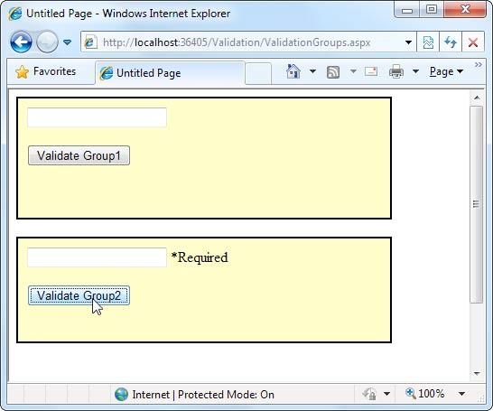
10.0 Building Better Forms - Validation
Figure 10.3-1– Validation Groups
What happens if you add a new button that doesn't specify any validation group? In this case, the button validates every control that isn't explicitly assigned to a named validation group. In the current example, no controls fit the requirement, so the page is posted back successfully and deemed to be valid.
If you want to make sure a control is always validated, regardless of the validation group of the button that's clicked, you'll need to create multiple validators for the control, one for each group (and one with no validation group).
30
30
Prepared By Kumar Peeris Web Application Development CSCI/CINF 4320
Prepared By Kumar Peeris Web Application Development CSCI/CINF 4320

